Slide 1





Slide 2



Problem Statement Data Collection Data Preprocessing Table Relationships Data Visualization Topline Summary
Customer Specific Analysis
Product Specific Analysis
City Specific Analysis
Conclusion About Us Acknowledgement
Content

Slide 3



Maven, a hypothetical North American MNC, sells FMCG in US, Mexico and Canada. It has been operational since 1997 and based on data from last two years:
Prepare a topline performance summary and shed light on performance based on KPIs.
Analyze the current customer base, by segments, and propose strategies to reach out to a wider demography.
Get insights based on individual products and investigate their geolocational performance.
Suggest changes in marketing and operational strategies, if any, which can facilitate expansion and/or increase profit margins.

Slide 4

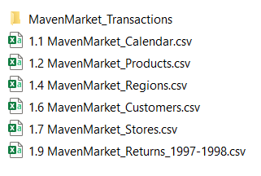



Slide 5

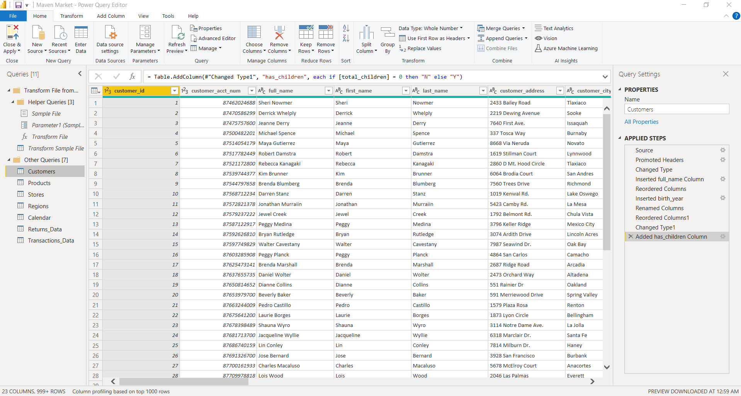
Power Query Editor
Data Preprocessing

Slide 6
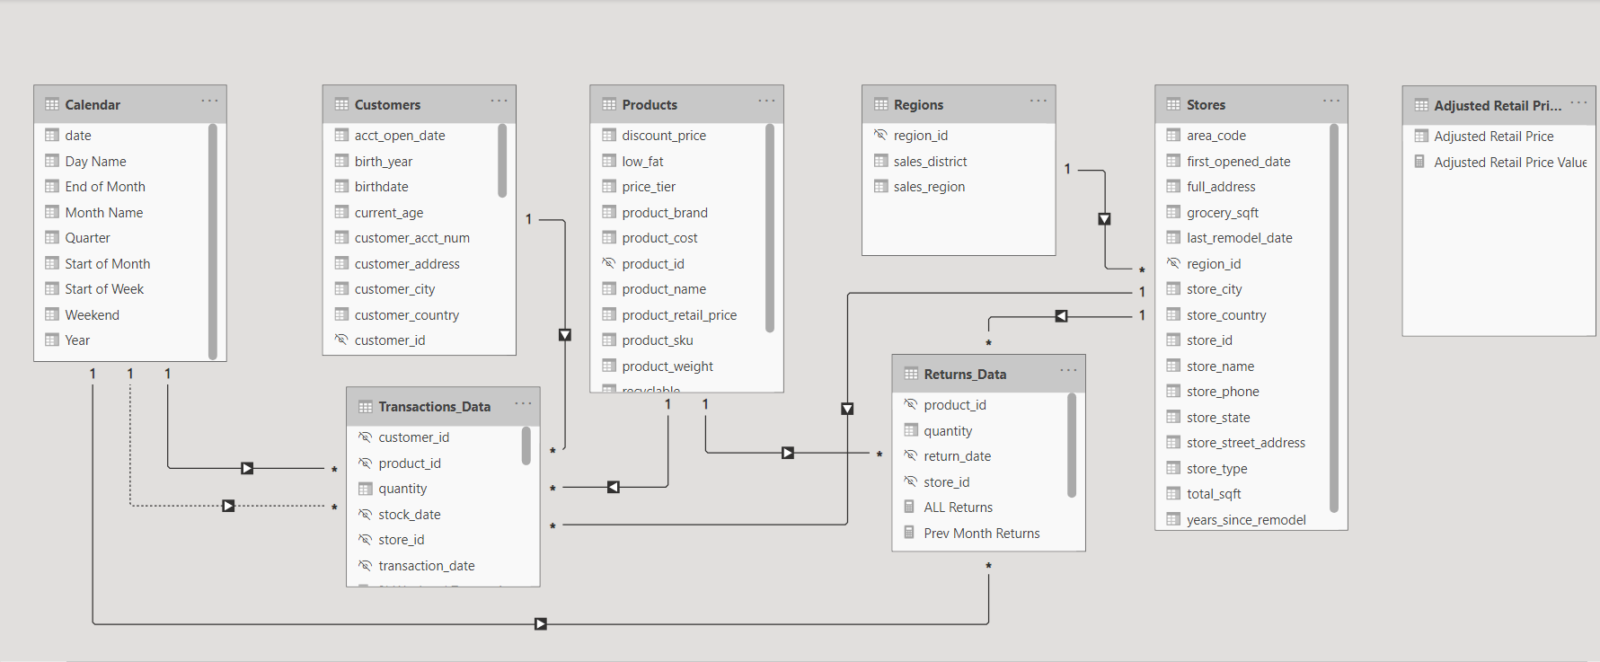
Relationship View
Table Relationships

Slide 7
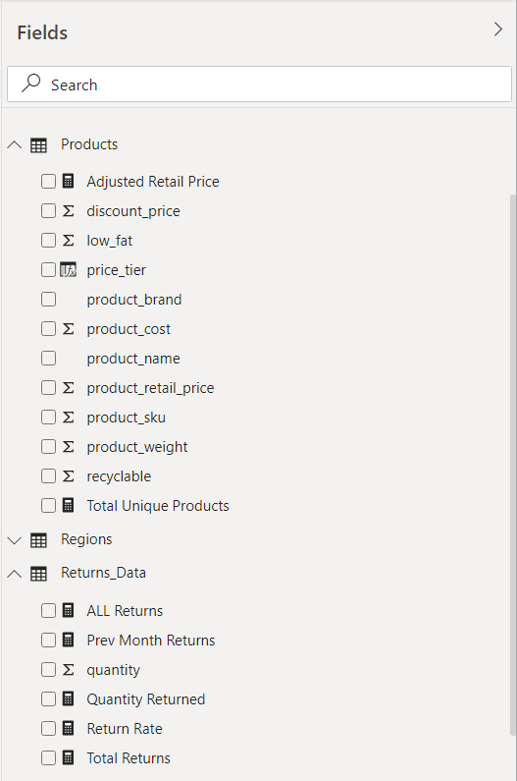
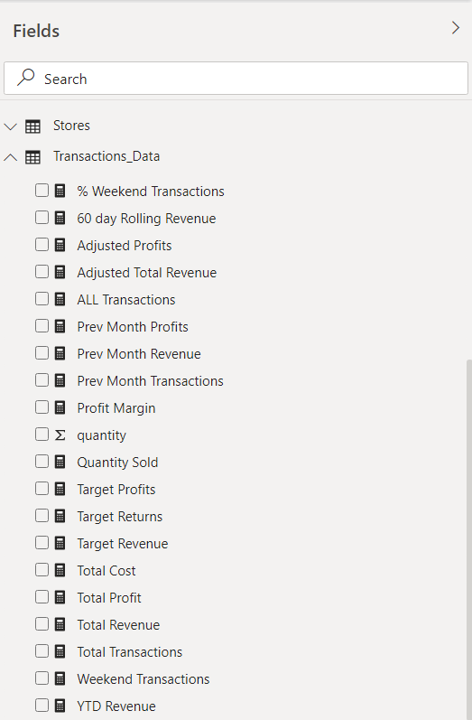
Creating DAX Measures
Data Visualization

Slide 8
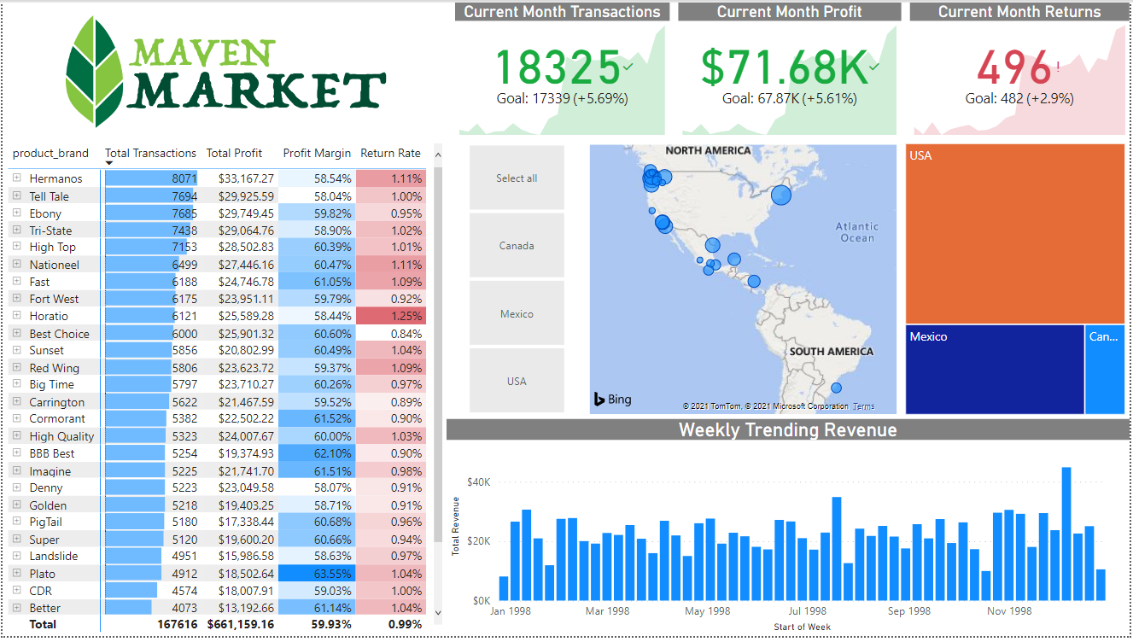
Topline
Summary

Slide 9

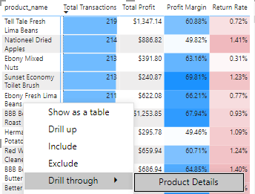

Lima Beans – A Case Study
Brief: This hierarchical matrix lists product name against number of transactions, profit generated in gross terms and its margin and the number of instances it was returned, as a percentage of transactions.
Drilling through, after seeing two occurrences of lima beans’ products in top-5, by transactions, revealed the following.

Slide 10
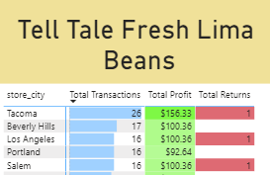
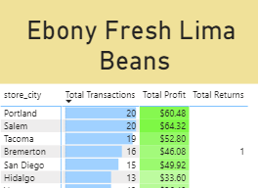
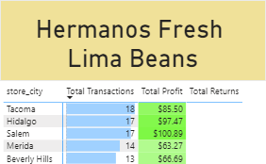
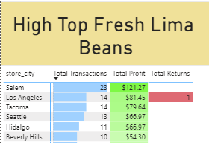
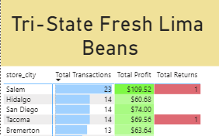
Insight: Five brands sell Lima Beans. The gross number of transactions in Mexico is 27.8%. Sales are concentrated in WA (Tacoma and Bremerton), OR (Seattle) and CA (Los Angeles, Beverly Hills, San Diego), all in US.
Recommendation: Increasing sales in Salem, MA and across Mexico, can further bolster profits, owing to preexisting high profit margins and cheaper production costs, by setting up small-scale processing plants, since Oaxaca, Mexico and Delaware, US are large producers of lima beans.

Slide 11
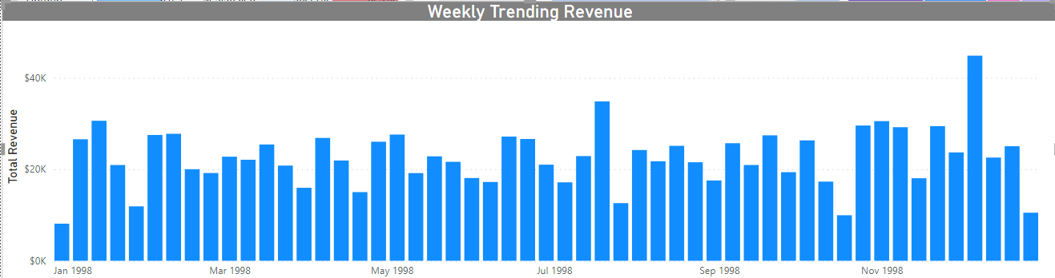
Insight: This visual depicts the sum of revenue generated throughout a week. There is a noticeable peak for 1998 in the first week of December. This can be attributed to increased shopping immediately after Thanksgiving, or beginning of preparation for ensuing year-end celebrations.
Also, all month-ends can have significant lulls, which are characteristic of lower expenditure towards the end of the month or national holidays (like Memorial Day, Halloween’s etc.)/annual event (income tax returns), on part of monthly-wage earners.
Recommendation: Keeping supplies in agreement with demand trends over past year(s)’ records, can help in making most of the swells, while mitigating the lows.

Slide 12
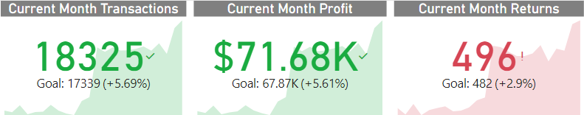
Insight: KPIs combine time-series with key metrics and reflect company’s goals in the long term. A benchmark is/not to be exceeded, depending on the statistic. For instance, products with return rate above 1% need to be alarmed.
Recommendation: In gross terms, rising returns aren’t too bothersome if the return rate is within the growth rate in transactions, since there is a correlation between the two. However, if this isn’t the case, returnees can be urged to fill a satisfaction survey to justify their reason.
These can be used to improve the firm’s products and services.

Slide 13
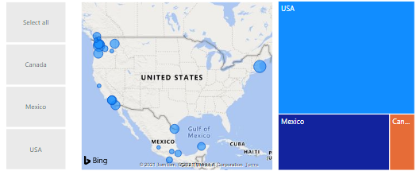
Location-based Insights
Brief: The slicer on the left, in addition to the tree map on the right, aids demonstrating geospatial distribution of revenue, by size of bubbles. While a hover on any one of them presents a galore of statistics for last one year, the tree map can be drilled to obtain revenue by store cities, which in turn can be drilled through to assess product trends and customer behavior by city.

Slide 14
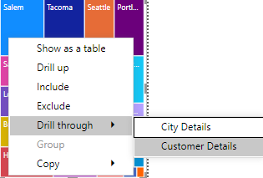

Contd.
Insight: Salem, when drilled through to customers tab, shows that most of its customers come from adjoining districts like Corvallis, Lebanon etc.
Recommendation: Setting up stores in aforementioned districts can be a safe expansion strategy.
Similarly, attempts to expand in similar locales (mainly on West Coast) and to increase sales volumes (mainly in Mexico) can become priorities, in face of sustained growth (which, in fact, is what the KPI cards suggest, for the two-year period in consideration).

Slide 15
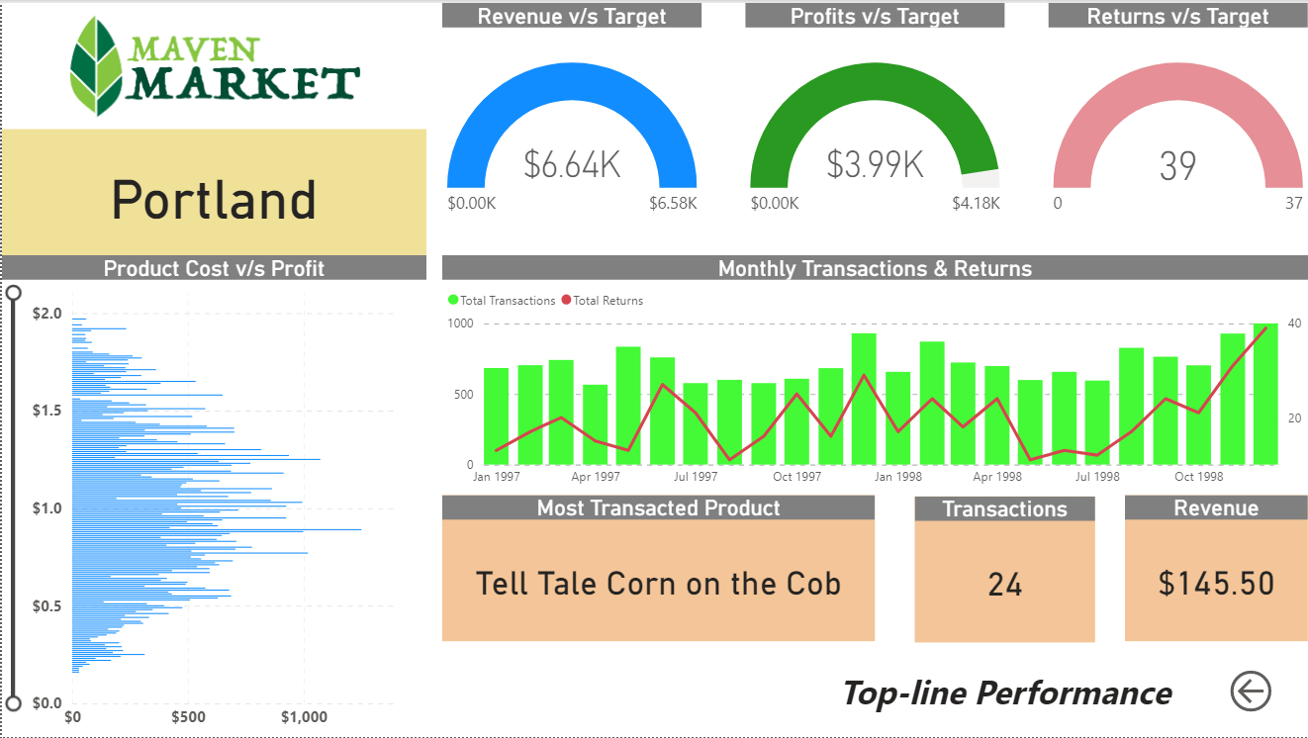
City
Specific Analysis

Slide 16
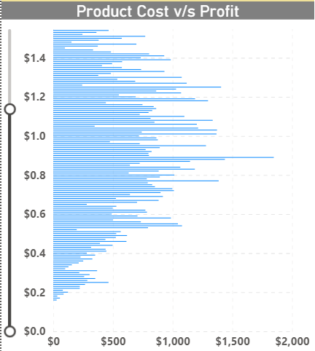
Drillthrough Filter – Salem, city with the highest revenue
Insight - Products with prices in range of 0.7$ - 1.2$ were able to fetch the maximum profit.
Recommendation – Decrease the production cost/relative cost of higher cost products or make products in this range to fetch the max profit.

Slide 17
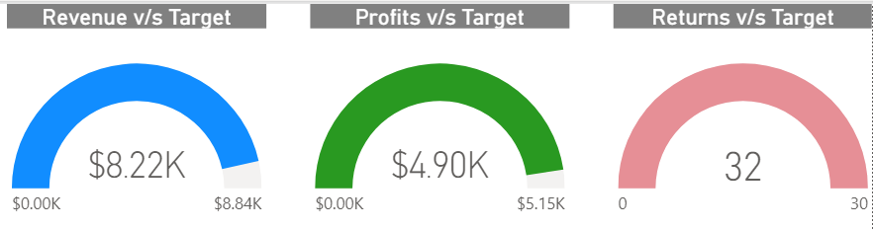
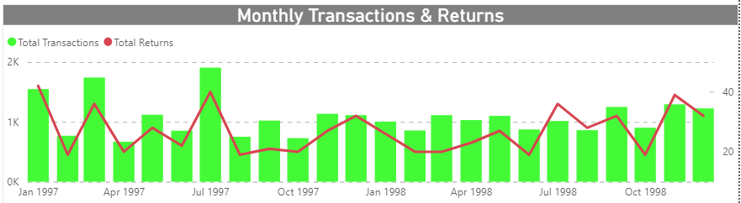
Insight - ­ Revenue : 93% , Profit : 95% , Returns : 6.67% (more) .
Recommendation – Considering the best performing city, if the above figures are achieved in other cities as well then, those cities are under the green zone while the other are red flags which needs to be focused.
Insight - From this we can calculate the Returns-Transactions ratio and then convert the ratio into percentage and average out all the percentages for each month.
Recommendation – The final value will be a transaction/returns predictor, given that we have any one of the data available.

Slide 18
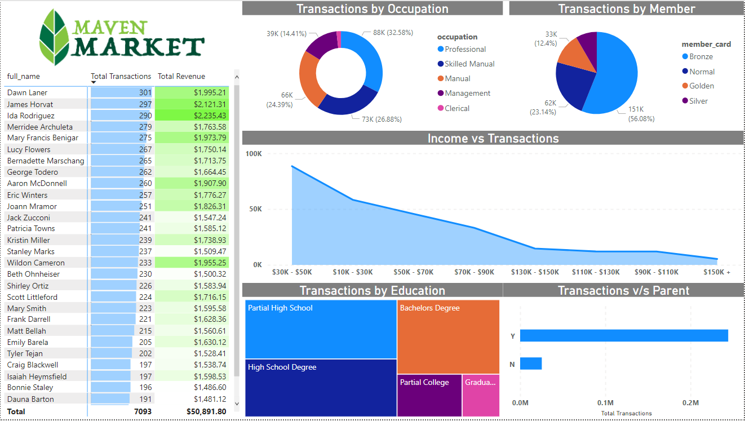
Customer Specific Analysis

Slide 19
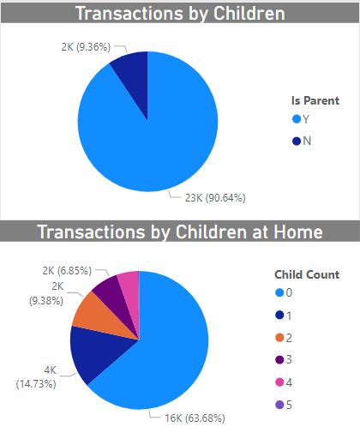
Recommendation – As a manufacturer and seller of FMCG goods, catering to more individuals with children can increase transaction frequency, who actively influence purchases as per a 1988 US Study.
Insight – The two charts, when read in conjunction, explain that parents not residing with their children represent nearly 64% of customer-base.

Slide 20
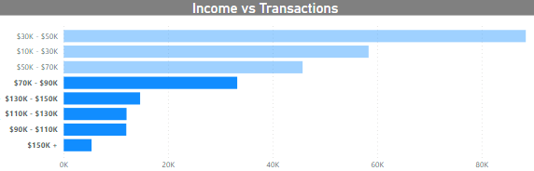
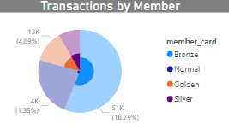
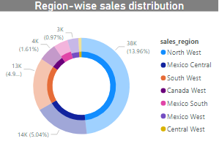
Insight: 28.63% of customers
earn more than $70,000 per year.
42.8% of bronze-card holders belong to this category and thus, avail special discounts.
36.9% of Mexico South customers fall in this bracket, highest among all sales’ regions.
Recommendation: Premium Pricing, targeting customers in this income slab, can enable an increase in overall profits.
The plan can be rolled out in Mexico South first.

Slide 21
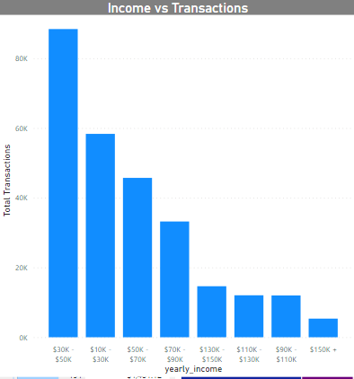
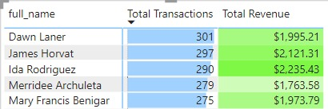
Insight: A matrix, in conjunction with other visuals, can be used to assess top-N revenue generating or transacting customers across categories (job, income, age, nationality et cetera).
Recommendation: Top-5 customers, who generated the most revenue in their respective income slab can be awarded gold membership cards directly, unlike other members, at the end of every year.
This can help increase brand loyalty and induce competitiveness among customers, to buy more.

Slide 22
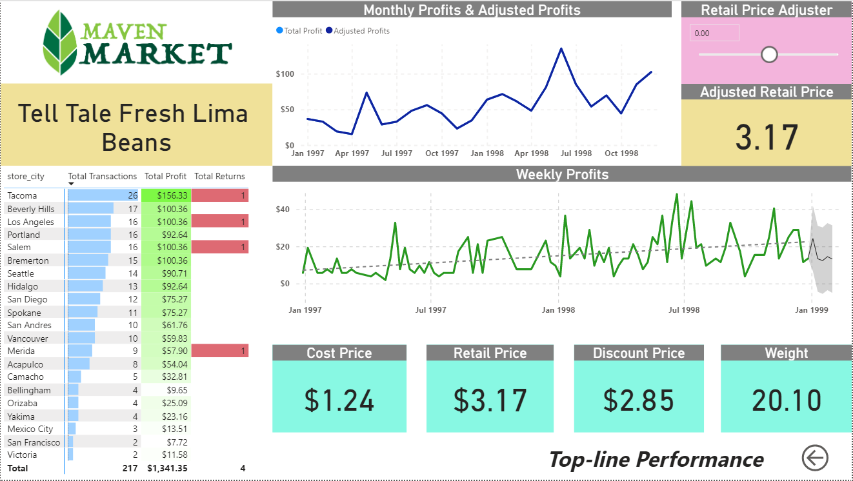
Product Specific Analysis

Slide 23
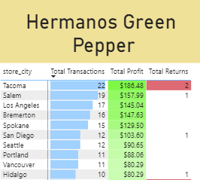
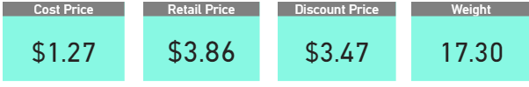
Product-based Insights
Brief: Drill-through filter enables us to drill down a product into its special “product detail” page.
From there, one can again drill-through into either the city/customer detail page.
Thus, self-guided intelligence is a powerful option.

Slide 24
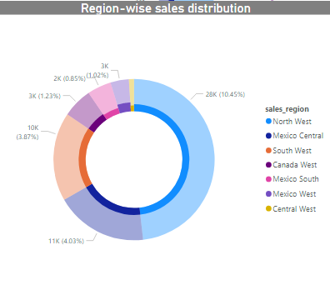
Contd.
Insight: “Hermanos green pepper” earns the most profit among all the products (from Topline Performance matrix). Of the cities selling it the most, the first Mexican entrant (Hidalgo) is on the 10th position. 27.6% of Mexico West customers earn less than $30k annually, the lowest across all sales regions (from customers page).
Recommendation: For such lower-income geographies, sachets can be used to drive sales. It is noteworthy that Mexico, despite being the second largest pepper producer in the world, doesn’t have its cities appear in the list.

Slide 25
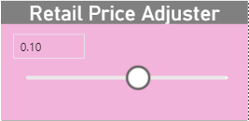
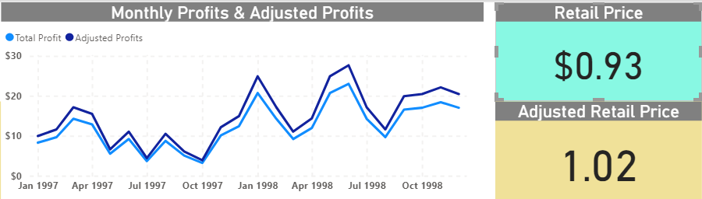
Price Adjustment Insights
Insight: Leveraging the what-if feature, one can visualize the effect of changing price of the commodity in consideration: Hermanos Potatos, on profits.
Recommendation: A change of 15-20% is palpable, on a 10% price change, while solely taking price into account.

Slide 26




Team’s Competence
Priyatam Piyush, a dexterous programmer, who, among various other disciplines, is well-versed with the intricacies of data science and guides the other members.
Yash Gupta is a web and application development enthusiast, who specializes in designing, machine learning, and data visualization as well.
Ayush Pareek dons the role of curating content and has an inclination towards economics, and data science.
About Us
Priyatam Piyush
Pursuing B.E from Jadavpur University.
An avid programmer, who has interned with multiple multinational companies.
He has a deep understanding of data science, development and analytics.
Patna, India
6201087076
piyushpriya34@gmail.com

Slide 27



Yash Gupta
Engineering sophomore at Jadavpur University.
Has a keen interest in web and app development, with emphasis on elegant designs
Has interned in web development roles and has a knack for solving complex problems.
Howrah, India
9330352781
yashgupta2673@gmail.com
Ayush Pareek
Engineering sophomore at Jadavpur University
Inclinations include data science and programming, with an innate desire to visualize and solve real-world problems
Worked as a content curator and core member at Entrepreneurship Cell
Howrah, India
7596868765
ayushpareek179@gmail.com

Slide 28
Thank You !

